Slide 1


PYTHON PROGRAMMING
TOPIC: Personal To-Do List Application
Name : Vasanthi Kumari P (Backend Developer for this project)
Pradeep Kumar Talavara(ppt presentation slides)
Notes:
1. JSON Format:
Structure:
JSON (JavaScript Object Notation) is a lightweight format that uses a key-value pair structure, allowing for hierarchical data organization.
It's commonly used for representing complex data, making it suitable for applications that require nested objects.
2. CSV Format:
Structure:
CSV (Comma-Separated Values) is a simple format that represents tabular data, where each line corresponds to a row, and values are separated by commas.
It’s best for flat data structures, where each record has the same set of attributes.

Slide 2

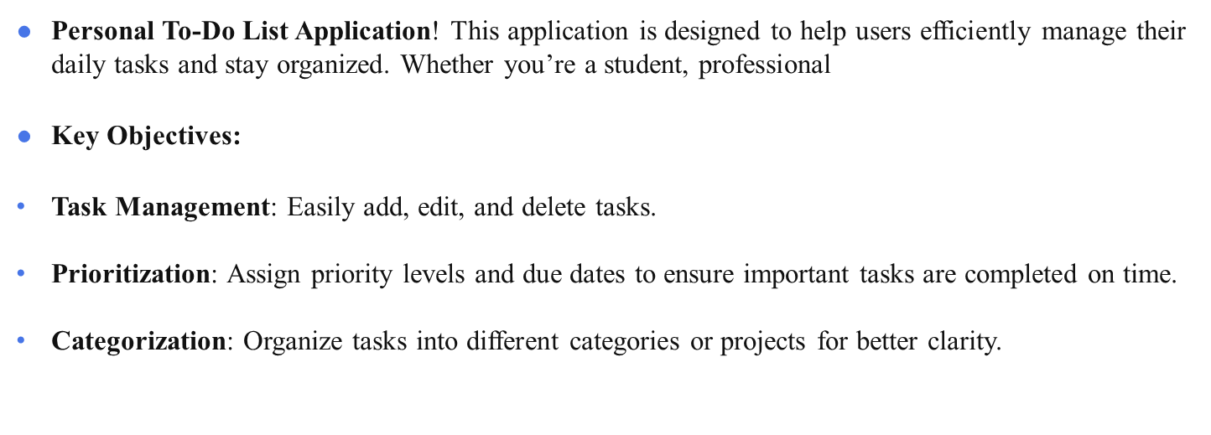
INTRODUCTION: BRIEF OVERVIEW OF THE APPLICATION

Slide 3
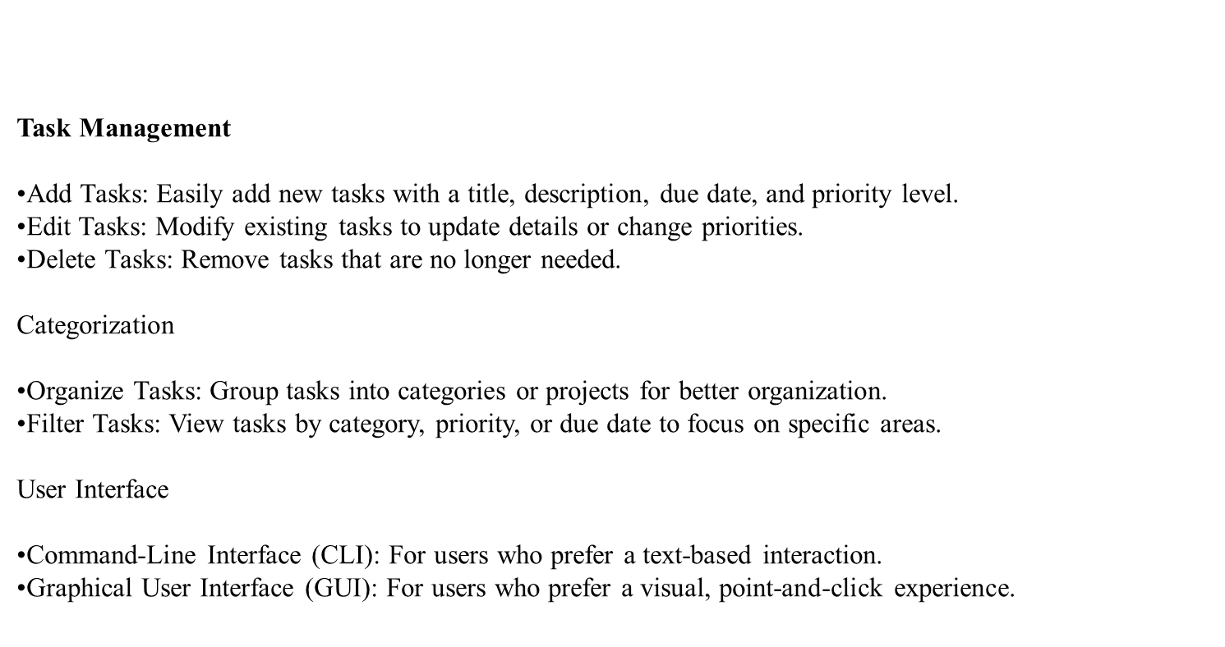
Application Features

Slide 4
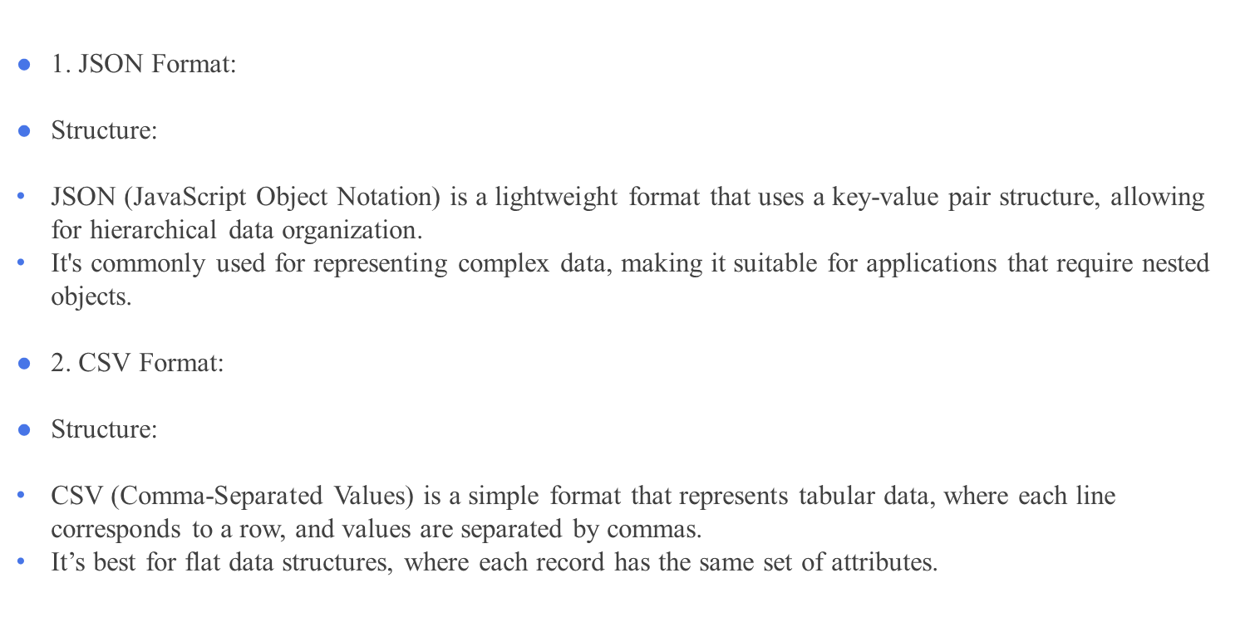
Data Storage in JSON and CSV Formats

Slide 5
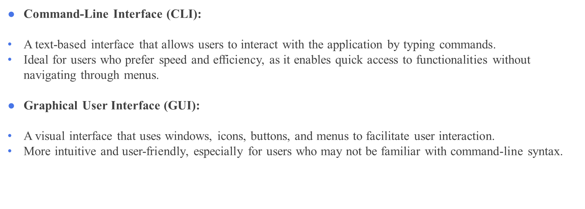
User Interface: CLI vs. GUI Interaction

Slide 6
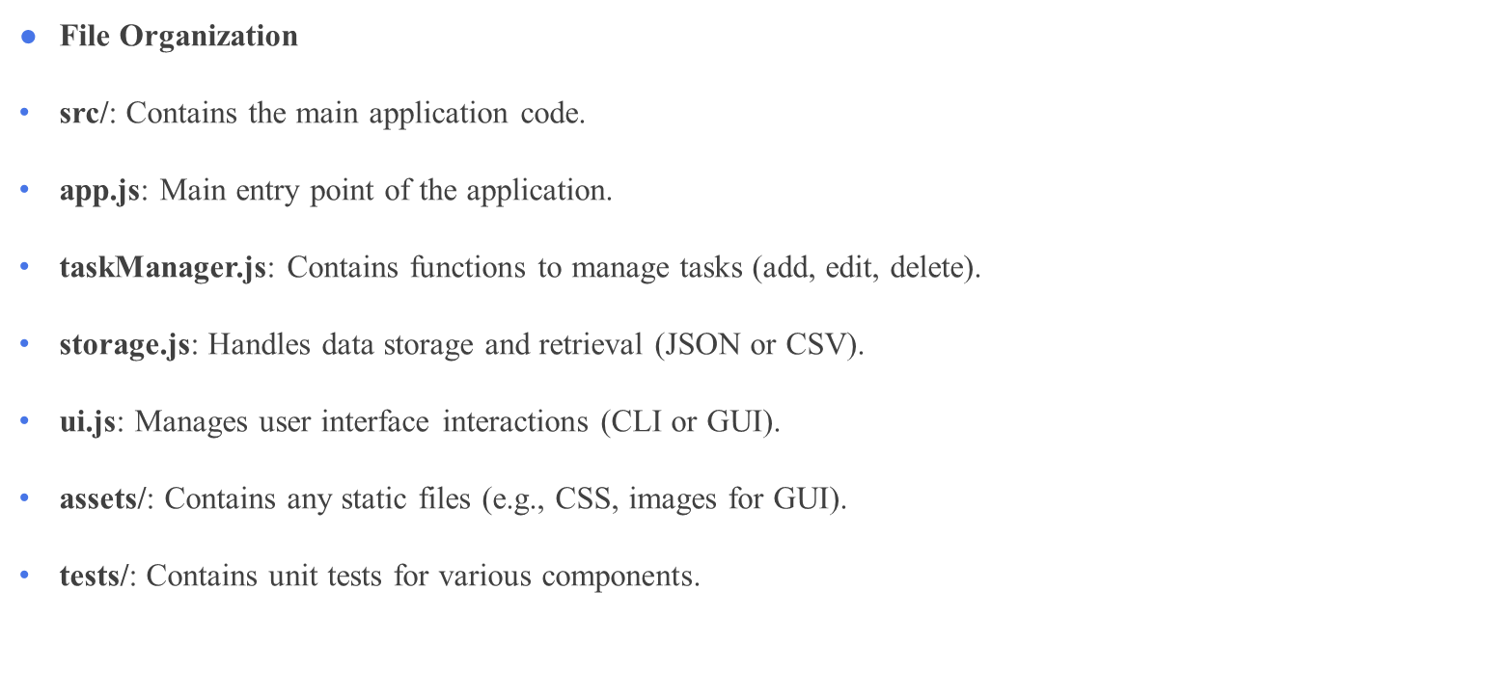
Code Structure Overview

Slide 7
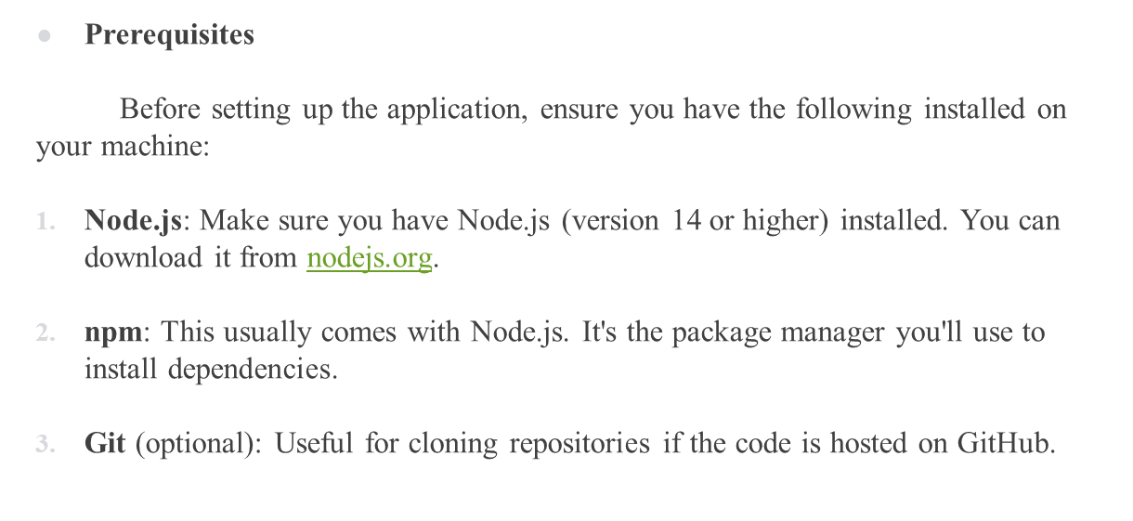
Installation Instructions for a Personal To-Do List Application

Slide 8
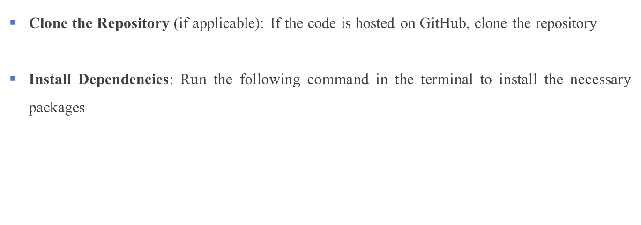
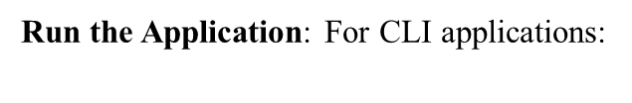
Step-by-Step Installation Guide

Slide 9
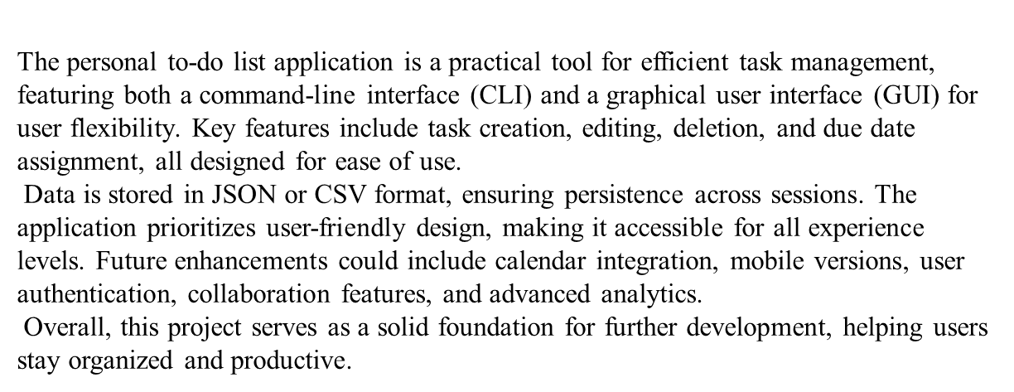
CONCLUSION

Slide 10
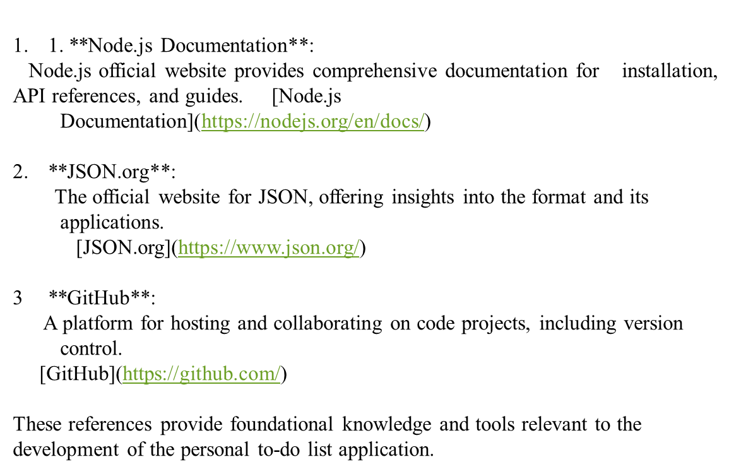
REFERENCES

Slide 11
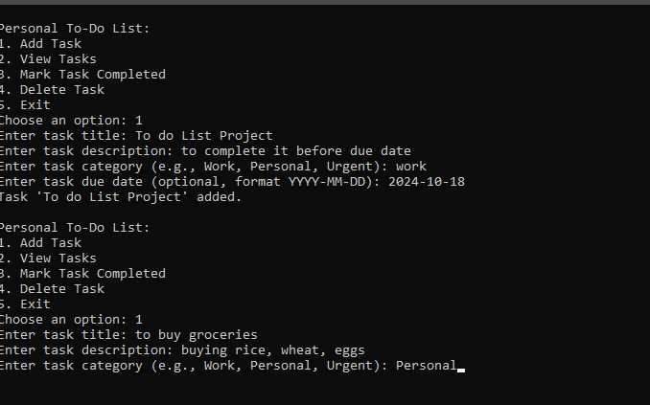
Output:

Slide 12

THANK YOU

